Slide 1

Windows CE System
2. Application Development
School of software Engineering
2005

Slide 2
Agenda
Tools and technology
Common application develop steps
Windows CE feature programming
Windows Mobile Development
  Pocket PC
  Smartphone
Emulator overview

Slide 3
Agenda
Tools and technology
Common application develop steps
Windows CE feature programming
Windows Mobile Development
  Pocket PC
  Smartphone
Emulator overview

Slide 4
What is App Development?
Given a specified Windows CE platform
Use the programming interface of the platform to implement kinds of functions.
The value of the platform lies in the applications run on it.

Slide 5
Development tools for Windows CE App Dev
Platform Builder
Embedded Visual C++
Visual Studio .NET
Embedded Visual Tools 3.0 (Deprecated)

Slide 6
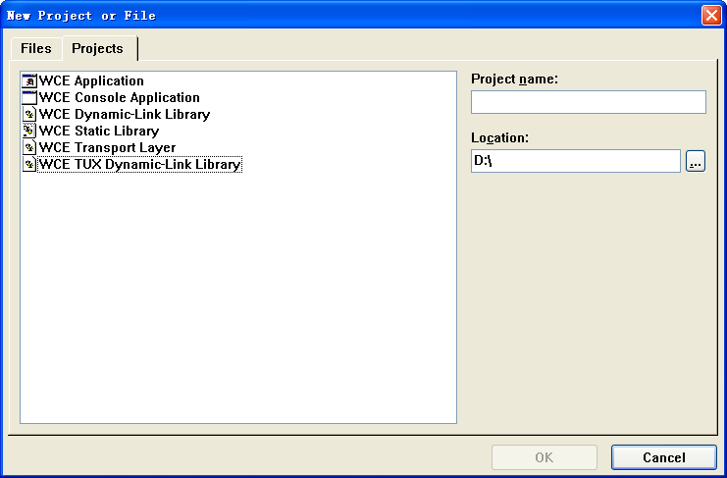
Platform Builder

Slide 7
Platform Builder
Support writing Win CE App / DLL / Lib using Win32 APIs
The application will be built into OS kernel
  Once modify the code, must make image again.
Easy to debug OS kernel, difficult to debug application
  Must generate a debug version of OS
  Debug Zone

Slide 8
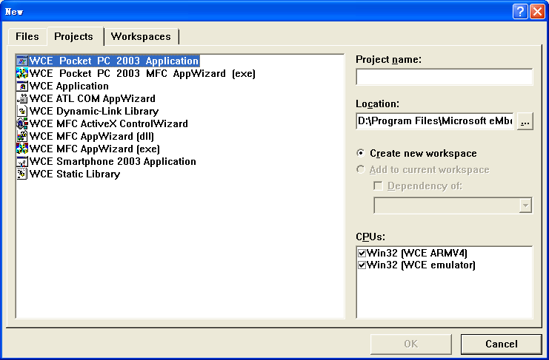
Embedded Visual C++

Slide 9
Embedded Visual C++
Support writing Win CE App / DLL / COM / Lib using Win32 API, MFC, ATL and STL
Same project management style and UI with Visual C++ 6.0
Easy for debugging and testing
Must install corresponding SDK before developing Apps for specified platform

Slide 10
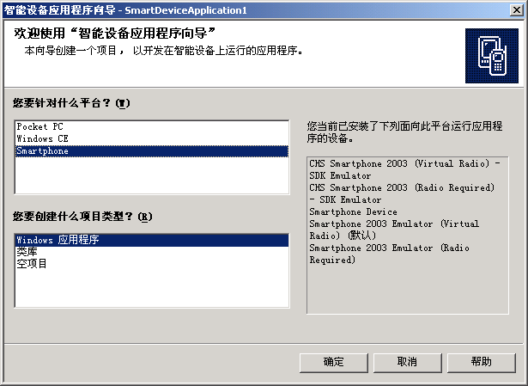
Visual Studio .NET

Slide 11
Visual Studio .NET 2003
Develop Windows CE App / Assembly using .NET compact framework
Can use C#, VB.NET, J#...
Integrated Develop Environment in VS.NET
Require .NET compact framework installed on your target platform
Easy for debugging and testing

Slide 12
Embedded Visual Tools 3.0
Includes Embedded Visual Basic 3.0 and Embedded Visual C++ 3.0
Same UI as Visual Studio 6.0
ONLY for Windows CE Version 3.0

Slide 13
Application Development Options
Native Application Model
Managed Application Model
Platform
Builder
eMbedded
Visual Tools
Visual Studio .NET
2003
C or C++
C or C++
C# or VB .NET
Win32
Applications
Win32
Applications
.NET Compact
Framework
Compiled
Runtime
Windows CE Operating System

Slide 14
Application Development Options (Future)
Platform
Builder
Visual Studio
2005
C or C++
C or C++
C# or VB .NET
Win32
Applications
Win32
Applications
.NET Compact
Framework 2.x
Windows CE Operating System

Slide 15
Related Technology
---- What’s your choice?
Win32
Microsoft Foundation Class (MFC)
.NET Compact Framework

Slide 16
Related Technology
---- Size impact
Runtime | Size (Byte) | Size Increment
Win 32 | 9,805,231 | 0
MFC | 10,234,415 | 429,184
.NET compact framework | 11,201,459 | 1,396,228
* Test is based on "Internet Appliance" platform

Slide 17
Related Technology
---- Devtime & Runtime performance
Develop time performance
.NET Compact framework
MFC
Win 32 API
runtime performance

Slide 18
Related Technology
---- Conclusion
The decision should be based on whether you have existing Win32/MFC/C#/VB code, the type of code you're writing (drivers, real-time, application), the overall size of your operating system image once the application and runtime have been included, the speed of development of the application, and other considerations such as security and portability. You can mix and match the code depending on which layer of the project you are working on: Win32 for drivers, Win32, MFC, or C#/VB for the end user application. The overall take away is that application developers really can use their desktop knowledge to be immediately productive with Windows CE.

Slide 19
Agenda
Tools and technology
Common application develop steps
Windows CE feature programming
Windows Mobile Development
  Pocket PC
  Smartphone
Emulator overview

Slide 20
Common Application Develop steps:
Get an SDK for specified Windows CE platform.
Writing Code and debug under Windows CE Emulator.
Make release build and run it on real target device, if necessary debug the app on device using ActiveSync.

Slide 21
Step1 : Get an SDK
SDK is used by EVC to develop Apps
Two ways of getting SDK
  Provided by Microsoft or 3rd party vendor
  Export SDK for our own platform
Microsoft Provides:
  Standard SDK (Common SDK dev)
  Windows Mobile SDK (Pocket PC…)

Slide 22
Export SDK Wizard in PB
A tool that creates and exports a software development kit (SDK) based on a particular customized platform. The exported SDK is a set of headers, libraries, run-time files, platform extensions, and Help documentation. Application developers can use the SDK in conjunction with Microsoft eMbedded Visual C++ 4.0 or Microsoft Visual Studio .NET to write applications for a custom platform.
Platform -> Configure SDK
Platform -> Build SDK

Slide 23
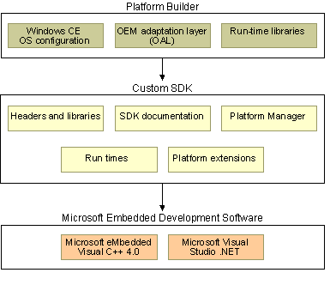
Relationship between PB, your SDK and Dev tools

Slide 24
Demo:
Export SDK from PB and use it in EVC

Slide 25
Tips :
Use your own SDK only if Standard SDK is not suitable.
Use Platform ->Configure SDK for detailed SDK configuration.
Uninstall SDK from Control Panel.

Slide 26
Step 2 : Coding and Debug under Emulator
Similar with Visual C++ 6.0 and Visual C++ .NET
Leverage your Windows Programming knowledge

Slide 27
Platform Manager
A communications technology that manages the communications between a development workstation and a CE target device. Platform Manager allows development tools to download and connect to the target device in a media-independent manner. PB, EVC 4.0, and the Microsoft .NET Compact Framework use Platform Manager to download files such as applications, Microsoft ActiveX controls, run times, and remote-tool clients to the target device.
Workstation
ActiveSync
CE Device
KITL
TCP / IP
Platform Manager

Slide 28
Remote Tools
You can use a development workstation to remotely perform a variety of programming tasks on target device.
Certain platforms support certain remote tools.
From Tools menu of both PB and EVC
Developer can create new remote tools using corresponding interface and APIs.

Slide 29
Tool Name | Description
Remote Call Profiler | Provides profiling and analysis tools within a graphical user interface (GUI) that enable you to identify algorithmic bottlenecks in your applications.
Remote File Viewer | Displays a hierarchical view of the file system on a target device.
Remote Heap Walker | Displays information about heap identifiers and flags for processes that are running on a target device.
Remote Kernel Tracker | Displays a representation of the execution of the operating system (OS) on a target device.
Remote Performance Monitor | Measures the performance of a target device.
Remote Process Viewer | Displays a list of processes and threads running on a target device.
Remote Registry Editor | Displays the registry for a target device and enables you to manage the registry.
Remote Spy | Displays a list of windows opened on a target device and messages generated by those windows.
Remote System Information | Displays system settings and properties for a target device.
Remote Zoom-in | Displays an image from the screen of a target device.

Slide 30
Demo :
EVC Hello World and Remote tools

Slide 31
Step 3 : Release, run and debug on target device
Make release build according to the CPU on the target device
Transport the executables onto the target device or build it into the OS image and run on the device
Perform step by step debug with ActiveSync if necessary.

Slide 32
Introduction to ActiveSync
ActiveSync provides support for synchronizing data between a Windows-based desktop computer and Windows CE .NET based portable devices. Using time stamps and user preferences, the synchronization process tracks data changes on both computers, then transfers the appropriate data so that each machine has the most-recent versions. Outdated or unwanted data is discarded.
ActiveSync supports serial, USB, infrared, modem, and Ethernet connections.
ActiveSync does not support synchronization between CE-based devices, nor between a CE device and a server.

Slide 33
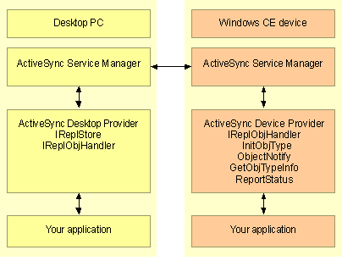
ActiveSync Model

Slide 34
Using ActiveSync to debug
Install ActiveSync from Microsoft website
Provide at least one connection between device and workstation
  Serial
  USB
  Infrared
  Modem
  Ethernet
Select “Windows CE Device” in EVC and debug on the device

Slide 35
Agenda
Tools and technology
Common application develop steps
Windows CE feature programming
Windows Mobile Development
  Pocket PC
  Smartphone
Emulator overview

Slide 36
GDI Programming
No TextOut API
Pay attention to CreateFont API
Does not arbitrate between the palettes of the foreground and background applications, palettes are not automatically padded with Windows systems colors.

Slide 37
Input : Stick
Do NOT use WM_MOUSEMOVE message, use GetMouseMovePoints API instead.

Slide 38
Windows CE Database
Win CE OS provides unique database APIs to support simple database function.
Can NOT be used under other version of windows.
APIs:
  CeCreateDatabase
  CeDeleteRecord
  …

Slide 39
Serial Port communication
// Traditional Win32 way.
hSer = CreateFile(TEXT(“COM1:”), GENERIC_READ, 0, NULL, OPEN_EXSITING, 0, NULL);
rc = ReadFile(hSer, &ch, 1, &cBytes, NULL);
TransmitCommChar(hSer, ‘a’);
CloseHandle(hSer);
Question : What can we use, besides “COM1”

Slide 40
RAPI
An interface that enables an application running on a desktop computer to make function calls on a Windows CE-based device. The desktop computer is known as the RAPI client and the Windows CE-based device is known as the RAPI server. RAPI runs over Winsock and TCP/IP.
API Usually begin with Cexxxx

Slide 41
RAPI Structrue
Win CE
Run RAPI Application
RAPI Server

Slide 42
Agenda
Tools and technology
Common application develop steps
Windows CE feature programming
Windows Mobile Development
  Pocket PC
  Smartphone
Emulator overview

Slide 43
Introduction to Windows Mobile
Windows Mobile is Microsoft's software platform for Pocket PCs and Smartphones.
Windows Mobile extends the familiarity of the Windows desktop to personal devices.

Slide 44
Windows Mobile Family
Pocket PC
Smartphone
Windows Automotive

Slide 45
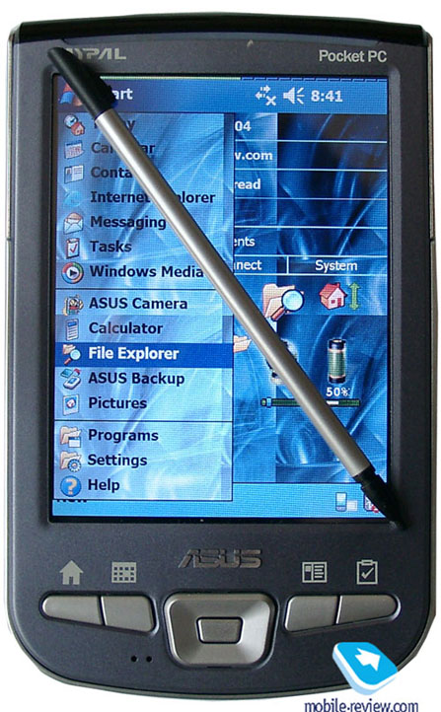
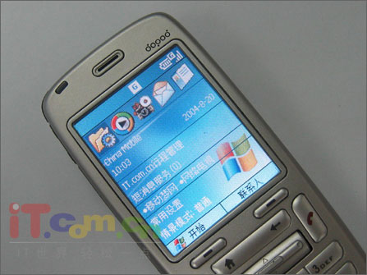
Pocket PC
Smartphone

Slide 46
Why Windows Mobile
The market for mobile devices is getting larger and larger
  By 2008, there will be over 100 million converged devices and 2 billion mobile phone subscribers (IDC, 2004).
Pocket PC is already widely used
Smartphone is growing rapidly

Slide 47
Windows Mobile Feature
Microsoft provides the Platform and SDK
OEMs provide the hardware
Developer can NOT modify the Platform features

Slide 48
Windows Mobile Develop
Step1 : download & Install SDKs
URL:
  http://msdn.microsoft.com/mobility/downloads/sdks/default.aspx
SDK can be used by both EVC and Visual Studio.NET 2003

Slide 49
Windows Mobile Develop
Step2 : Develop, Debug and Run
Reference to previous slides

Slide 50
You need to know.
1. use ONLY Unicode char set
  a. ANSI is one byte, UNICODE is two
  b. declaration：
    CHAR->WCHAR or TCHAR
  c. string function：
    strlen( )->wcslen( )
    strcmp( ) -> wcscmp( )

Slide 51
You need to know (2)
2. Pay attention to memory usage
  Decrease the number of static and global variables.
  Pay great attention on function recursion
  Notice the size of picture, sound…
  Check after dynamic memory allocation

Slide 52
You need to know (3)
3. Check the screen resolution
  620×240、240×320 ….

Slide 53
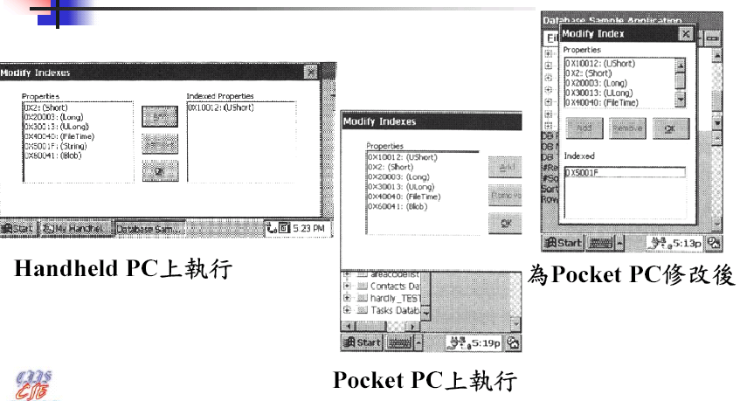
Screen resolution sample

Slide 54
Where are we?
Get platform & SDK from OEMs
Export your SDK
Coding & Testing
Release to Manufacture

Slide 55
Agenda
Tools and technology
Common application develop steps
Windows CE feature programming
Windows Mobile Development
  Pocket PC
  Smartphone
Emulator overview

Slide 56
Overview
The Emulator is a tool that mimics the behavior of hardware that supports a Windows CE–based platform.
With the Emulator, you can design and build a Windows CE–based platform and test it using software that mimics hardware rather than testing the platform on hardware.
Use software to emulate hardware.

Slide 57
Related software
Microsoft Virtual PC
VMWare
Share sourced Bochs

Slide 58
Usage Scenarios
Platform Developer
  DMA support
  Support KITL and can debug an OS
Application Developer
  Deliver it with your SDK
  Test your application before running on real device

Slide 59
Mapping a Directory to the Emulator
With the Emulator, you can connect to a directory on your development workstation as if the directory were a drive mounted on the Emulator. In the file system for the Emulator, the directory that the Emulator connects to appears at the root level as Storage Card. You can connect the Emulator to only one directory at a time.

Slide 60
Mapping a Directory to the Emulator
To map a directory to the Emulator
  On the Emulator, run a Windows CE OS that supports the ability to connect to a directory on the development workstation.
  In the Emulator window, from the Emulator menu, choose Folder Sharing.
  Choose Share Folder.
  Select a directory to share, and then choose OK.
To remove a mapped directory
  In the Emulator window, from the Emulator menu, choose Folder Sharing.
  Under Shared Folders, select the path to the directory.
  Choose Un-Share.

Slide 61
Emulator Limitations—
Communications and Networking
Emulator runs with outgoing network address translation (NAT) connections.
Dial-up Networking does not work
Can not establish a Remote Desktop Protocol (RDP)
Does not support:
  IrDA
  Bluetooth
  802.11

Slide 62
Emulator Limitations—
Hardware Limitations
Universal serial bus (USB) devices
PC Card devices
Storage devices, which include compact flash (CF) cards and hard disks
File system drivers, which include file allocation table (FAT), compact disc (CD), and digital video disc (DVD) drivers
IEEE 1394 devices

Slide 63
Emulator Limitations—
Multimedia Limitations
Does not support hardware acceleration for multimedia.
  DirectX
  Windows Media
DVD-Video API
Digital rights management (DRM)
Voice over IP (VoIP)
Multiple-screen support

Slide 64
In next section, we will move to real hardware

Slide 65
Homework
Export the SDK of your own windows CE platform in PB
Rewrite your tictactoe in EVC use your own SDK using MFC if possible, at least include the following feature:
  User can choose the block dimension
  Save the game result into Win CE DB. (Ex: 23 win 10 lose)
Migrate the game onto pocket PC and smartphone (No mouse…)

